Slide 1

Solid Propulsion Team
Weekly Report

Slide 2
Tasks Completed
Machining of nozzles #105
Port to throat ratio # 3
Design of grain casting mold #108
Slicing the stl files of casting molds for 3D- printing #109
Cooking Grains #83
Repairing the test stand #110
Procurement of materials #115

Slide 3
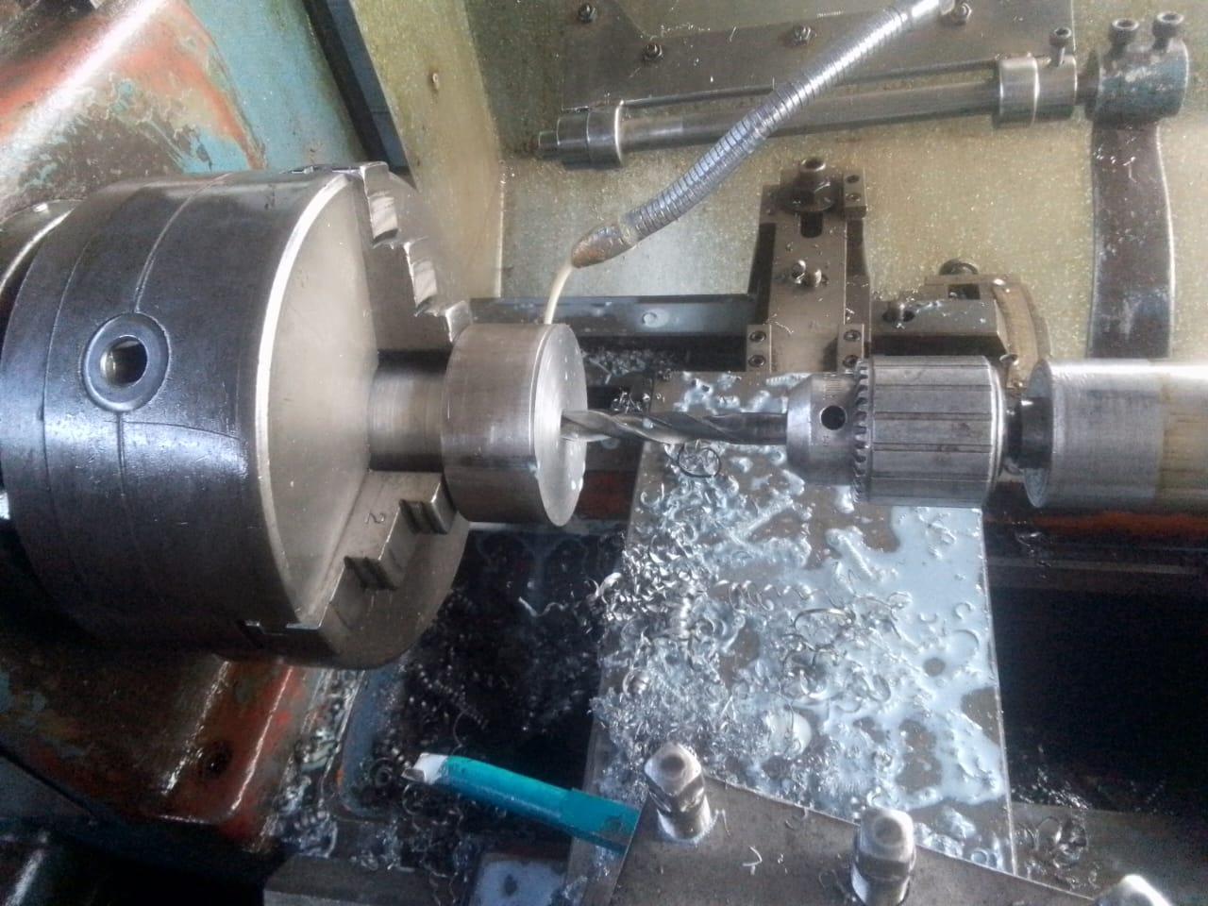
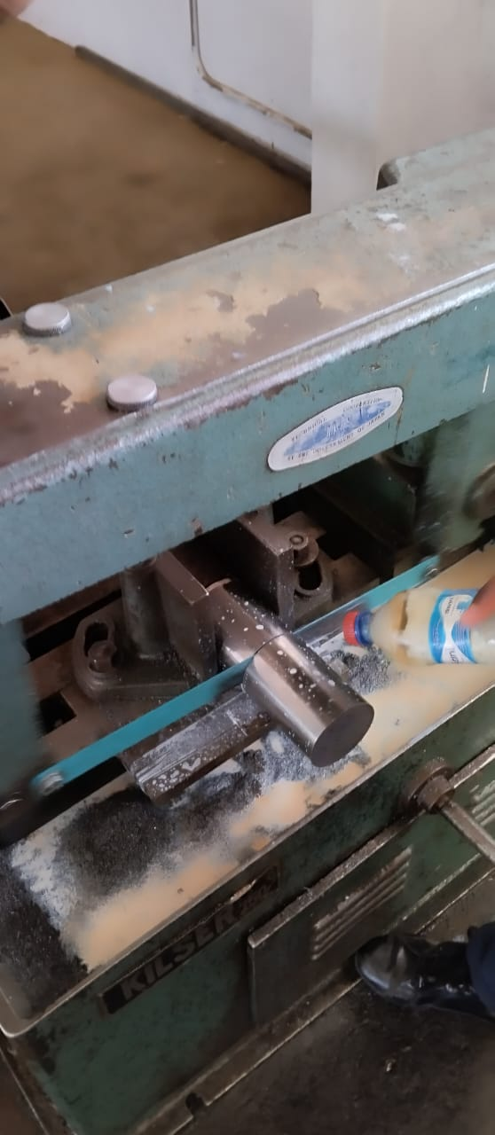
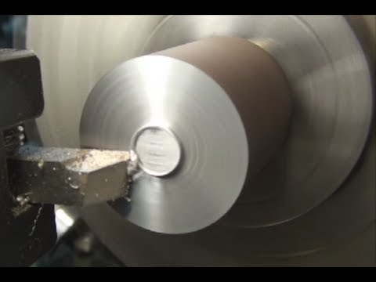
#105 Machining of Nozzles
Operations carried out:
Cutting the workpiece
Facing
Drilling

Slide 4
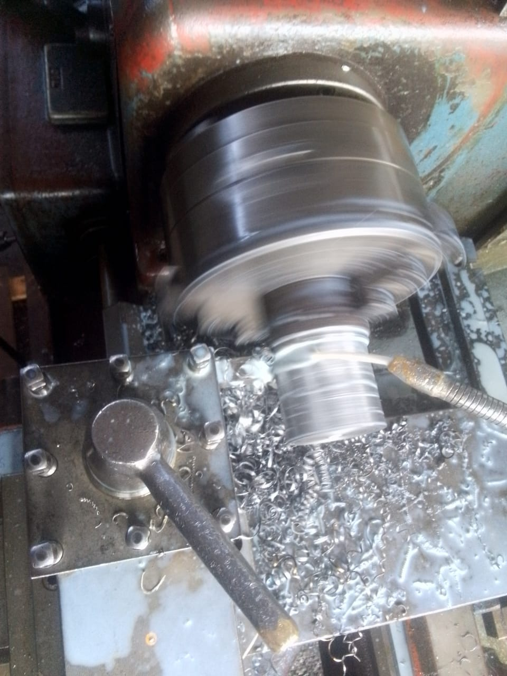
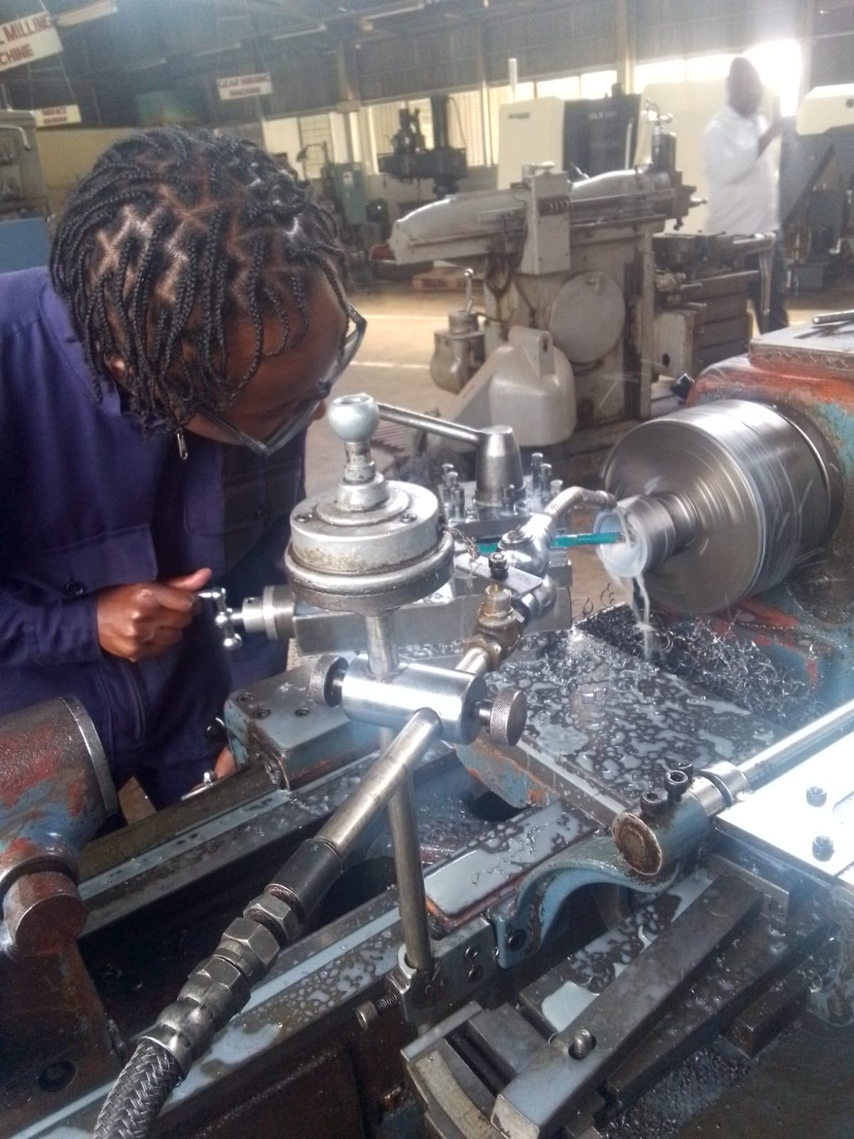
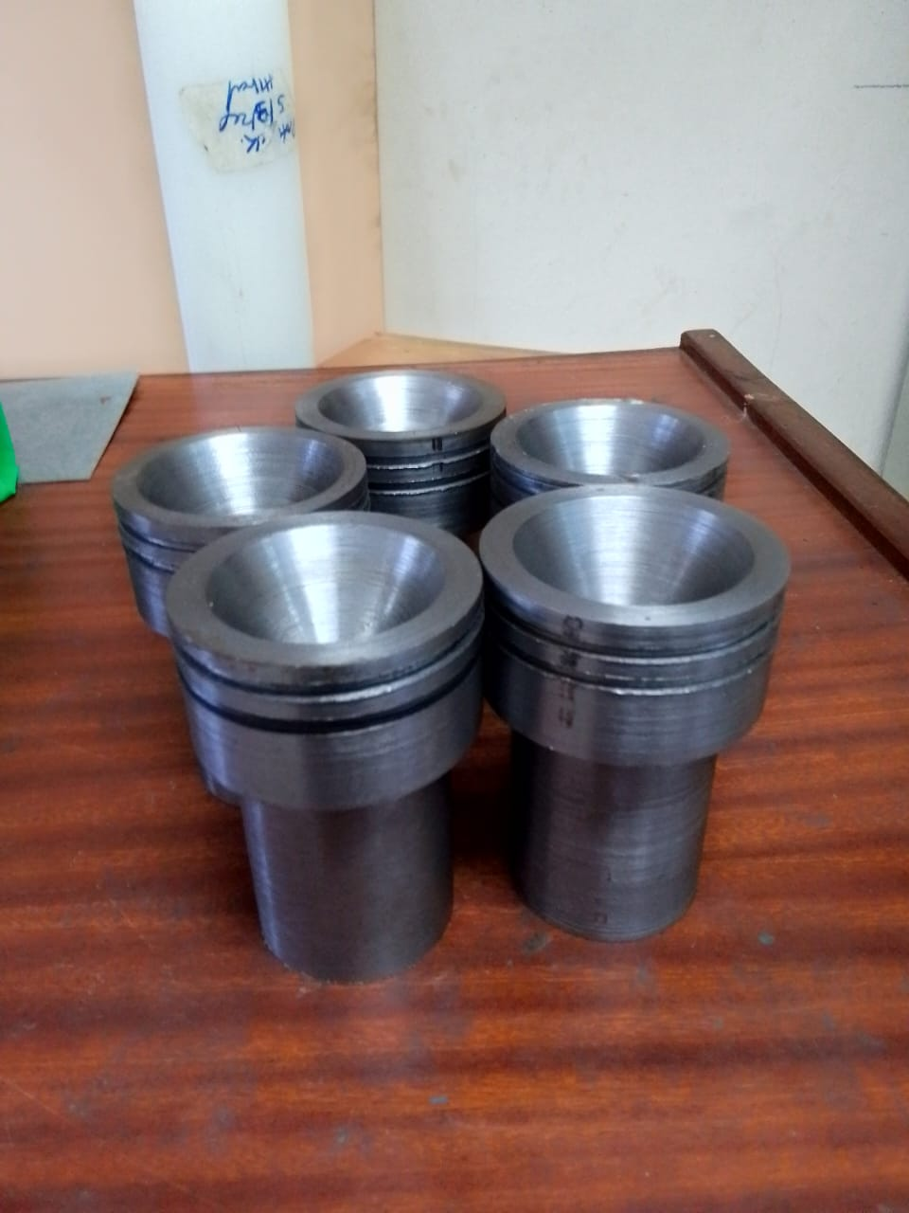
Continued
Turning
Boring
Machined Nozzles

Slide 5
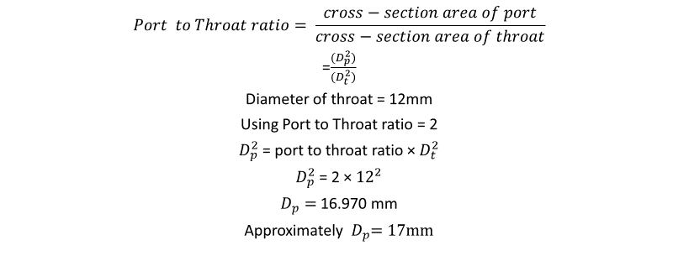
#3 Port to throat ratio = 2

Slide 6
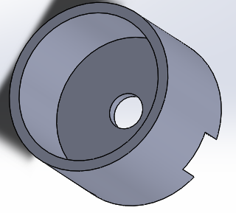
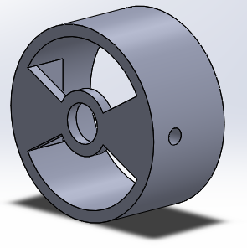
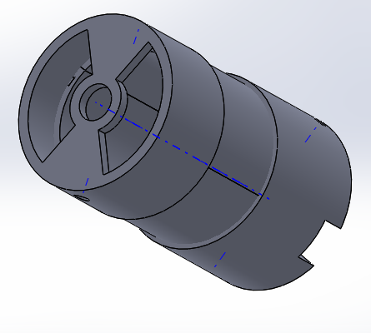
#108 Design of grain casting mold
Mold base
Mold top
Mold assembly

Slide 7
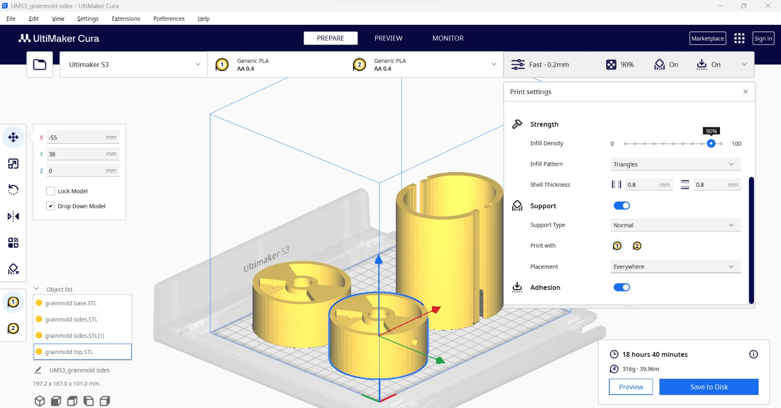
#109 Preparing 3D printing files
Made Ultimaker Format Packages (ufp) files

Slide 8
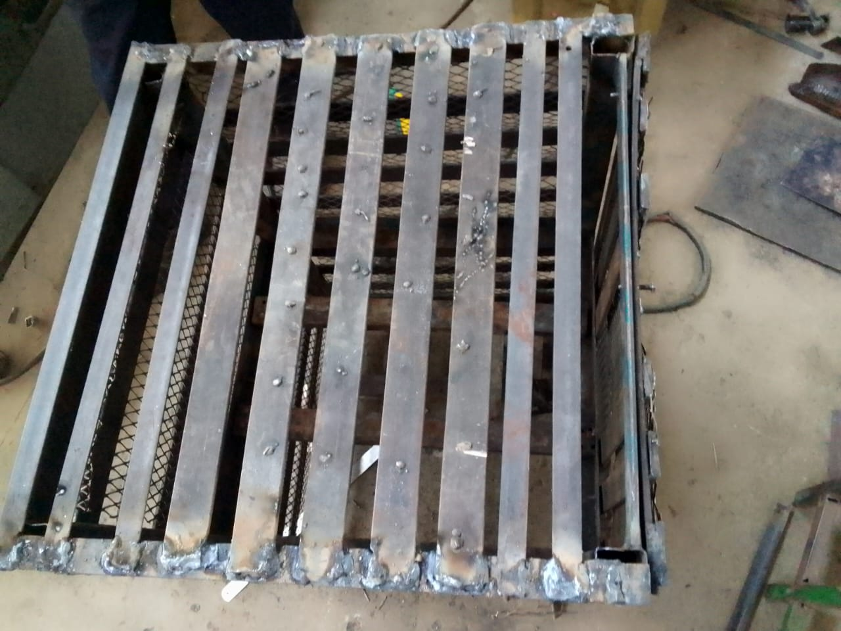
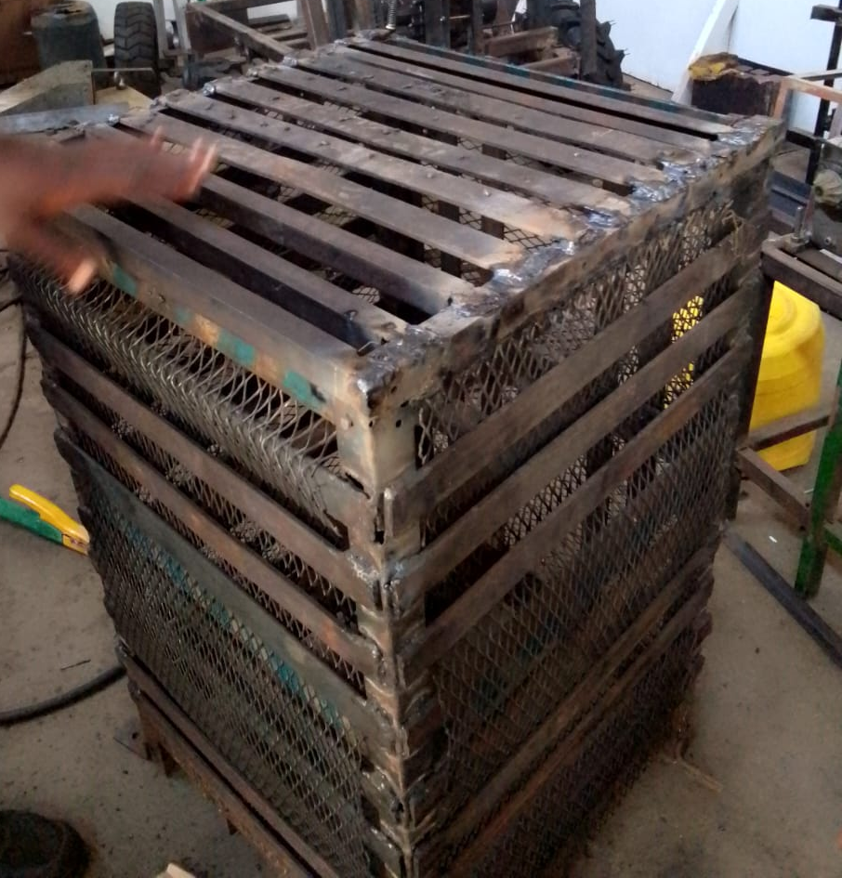
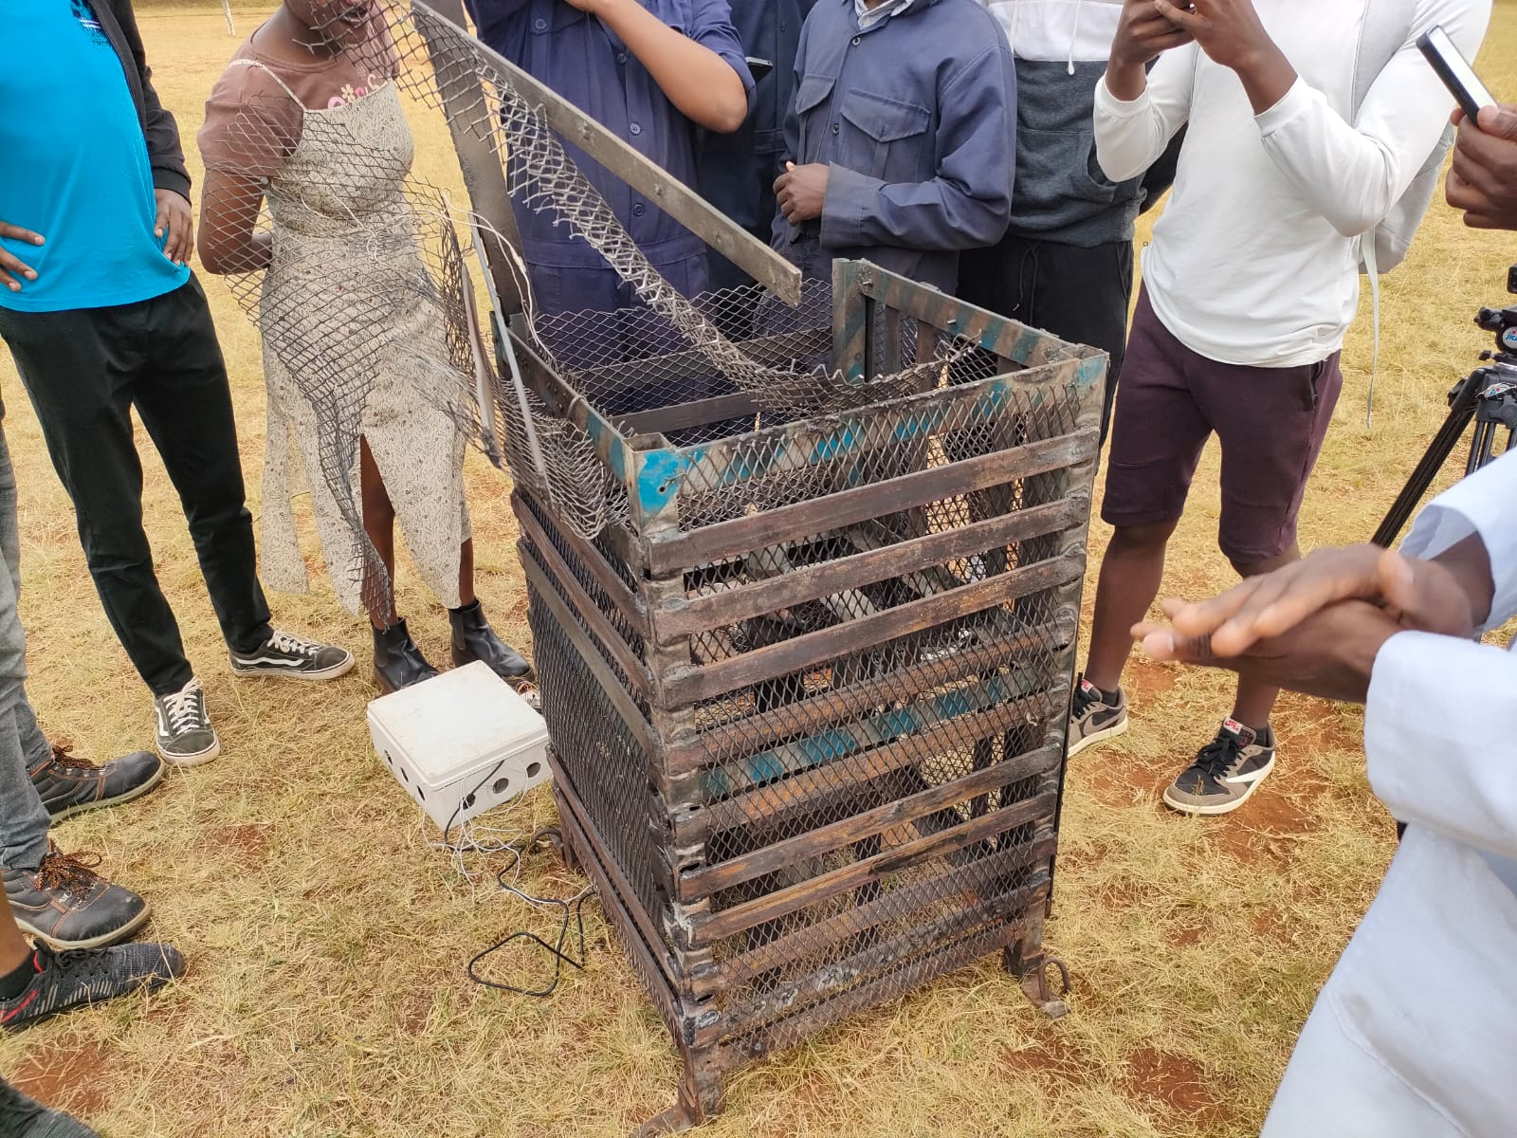
#110 Repairing test stand
Before repair
After repair

Slide 9
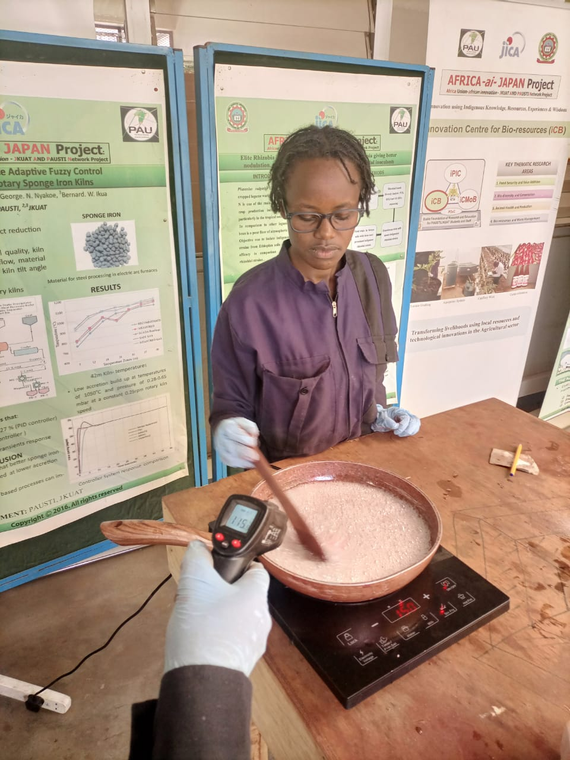
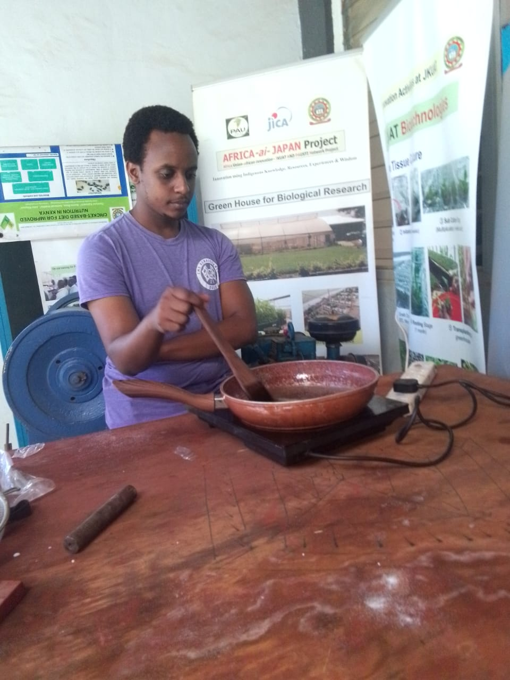
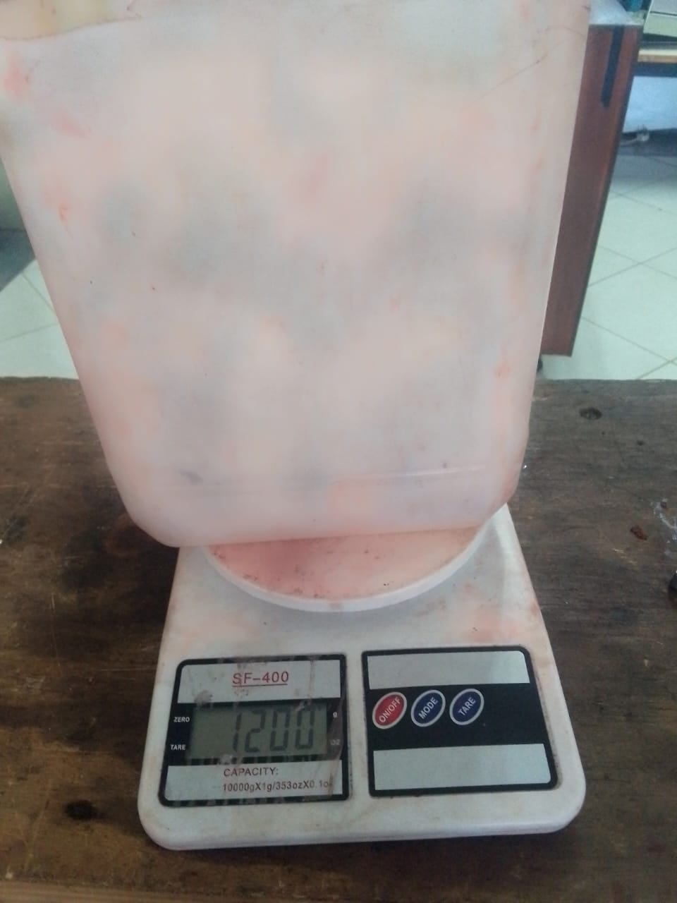
#83 Cooking of grains
Steps of preparing the grains:
Preheating sobital
Weighing of ingredients

Slide 10
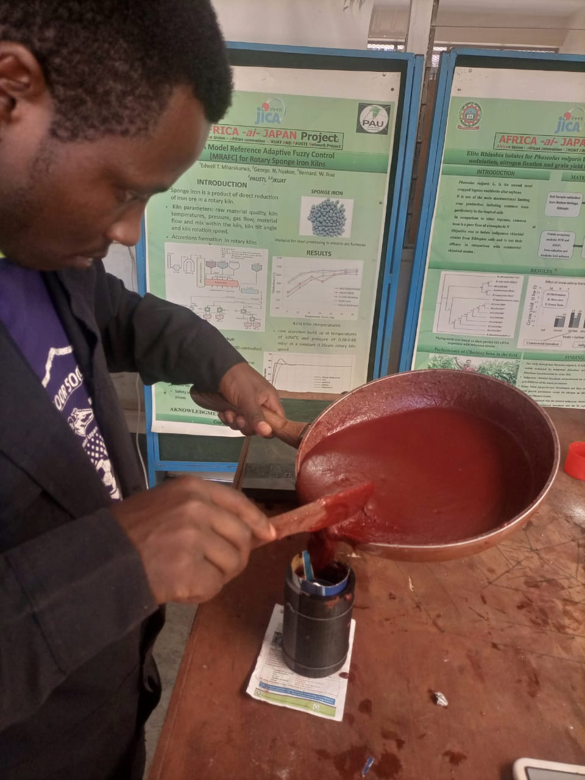
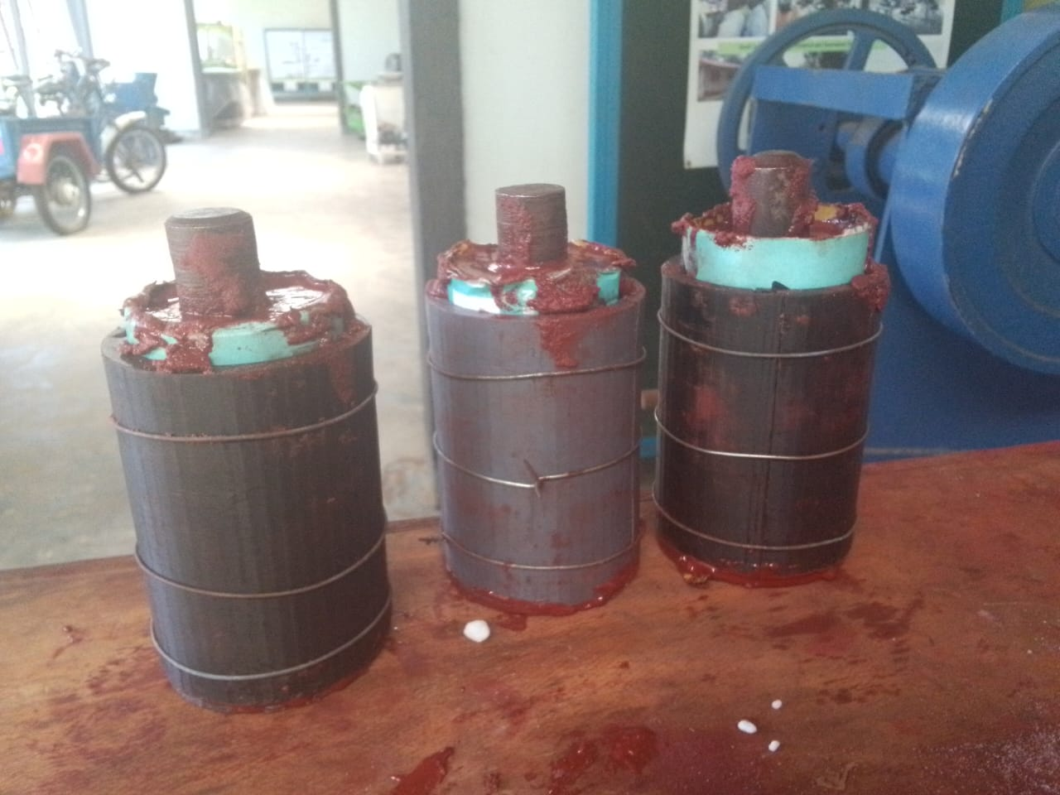
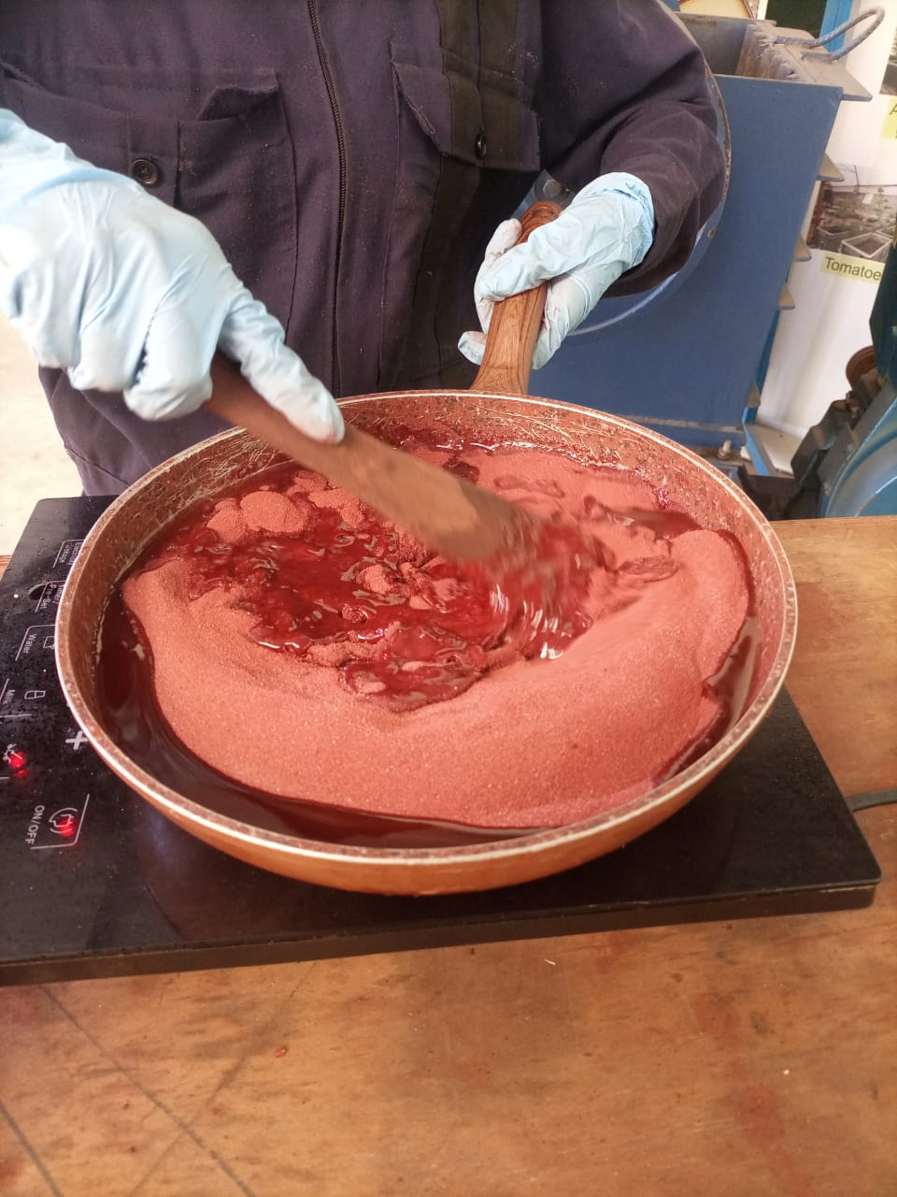
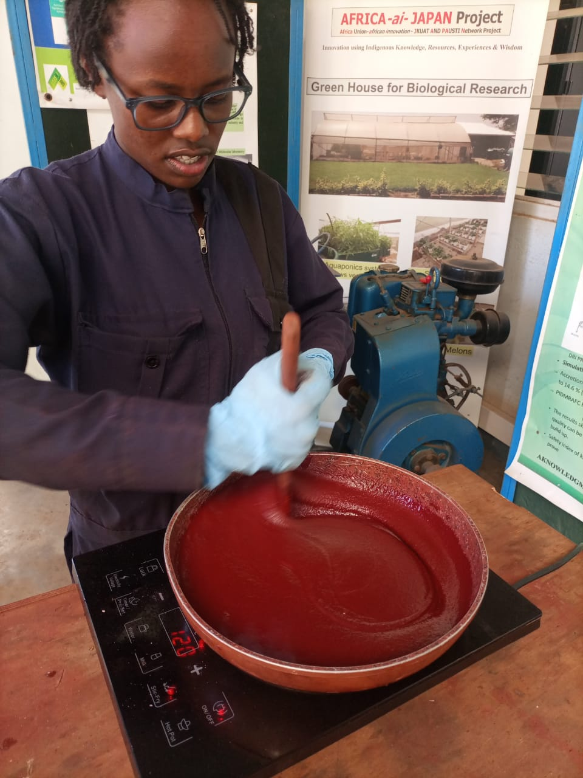
Continued
Cooking the chemical mixture
Casting in mold

Slide 11
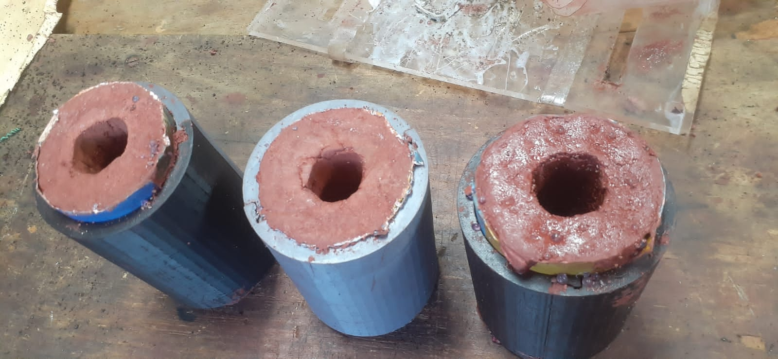
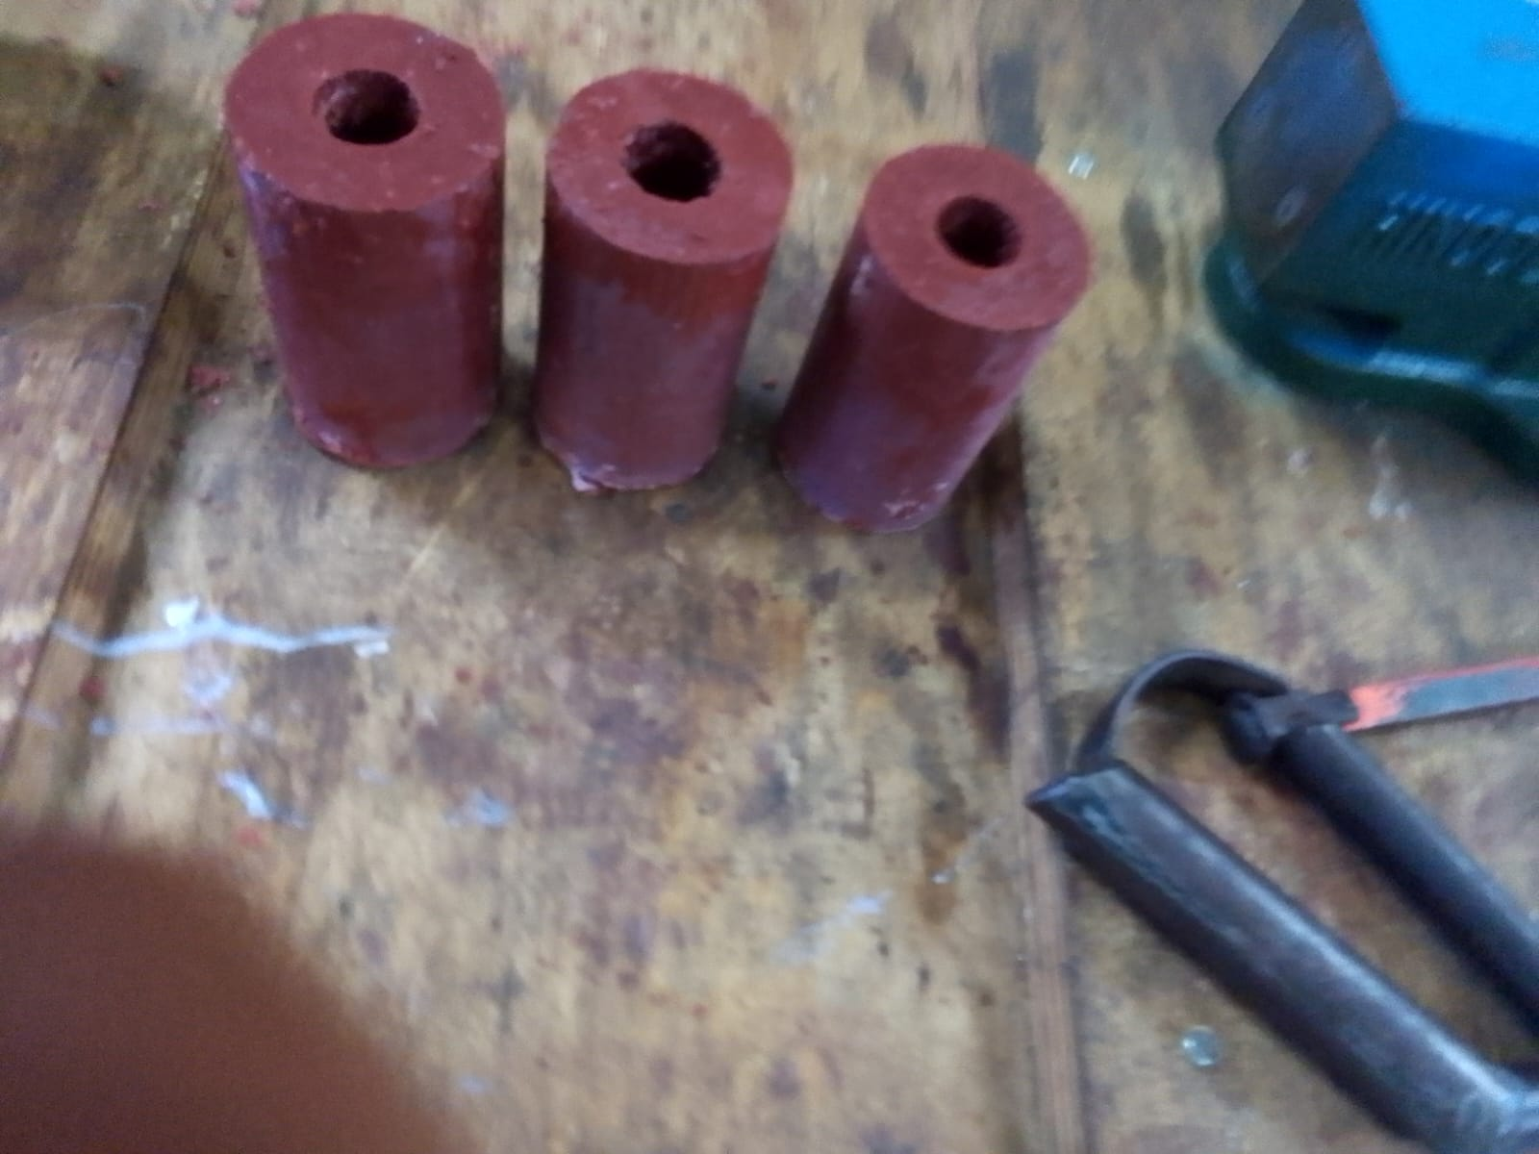
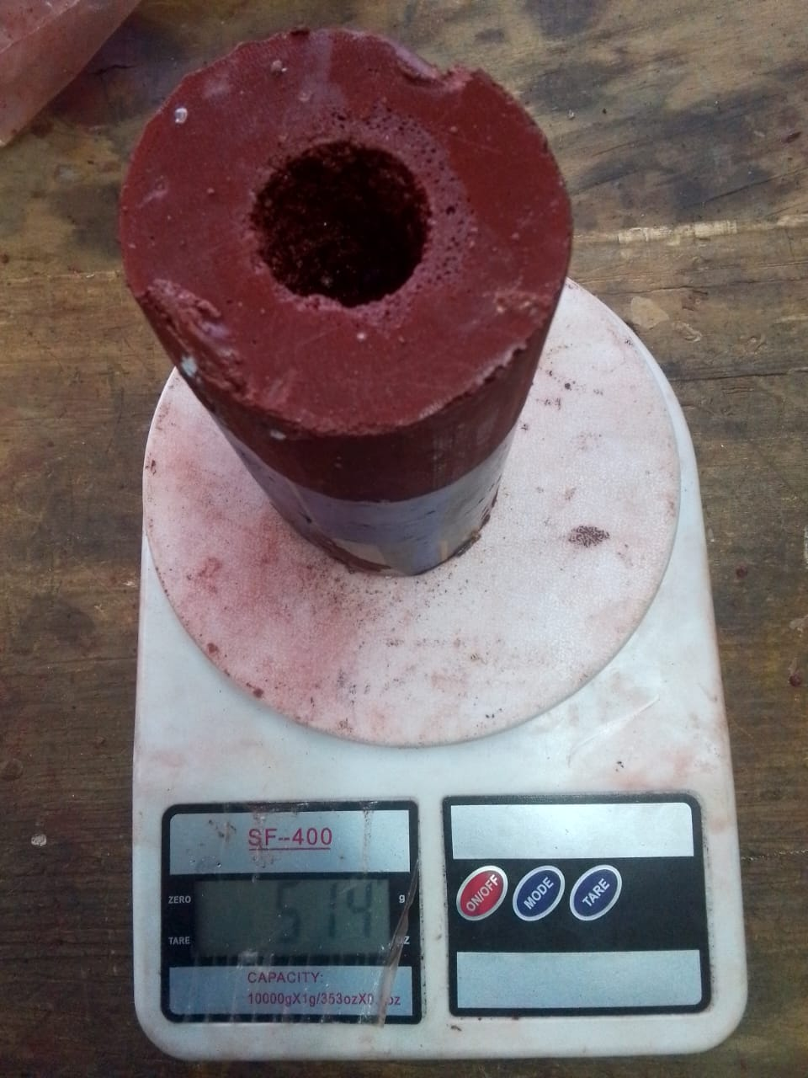
Continued
Removing core rod
Demolding
Weighing grains

Slide 12
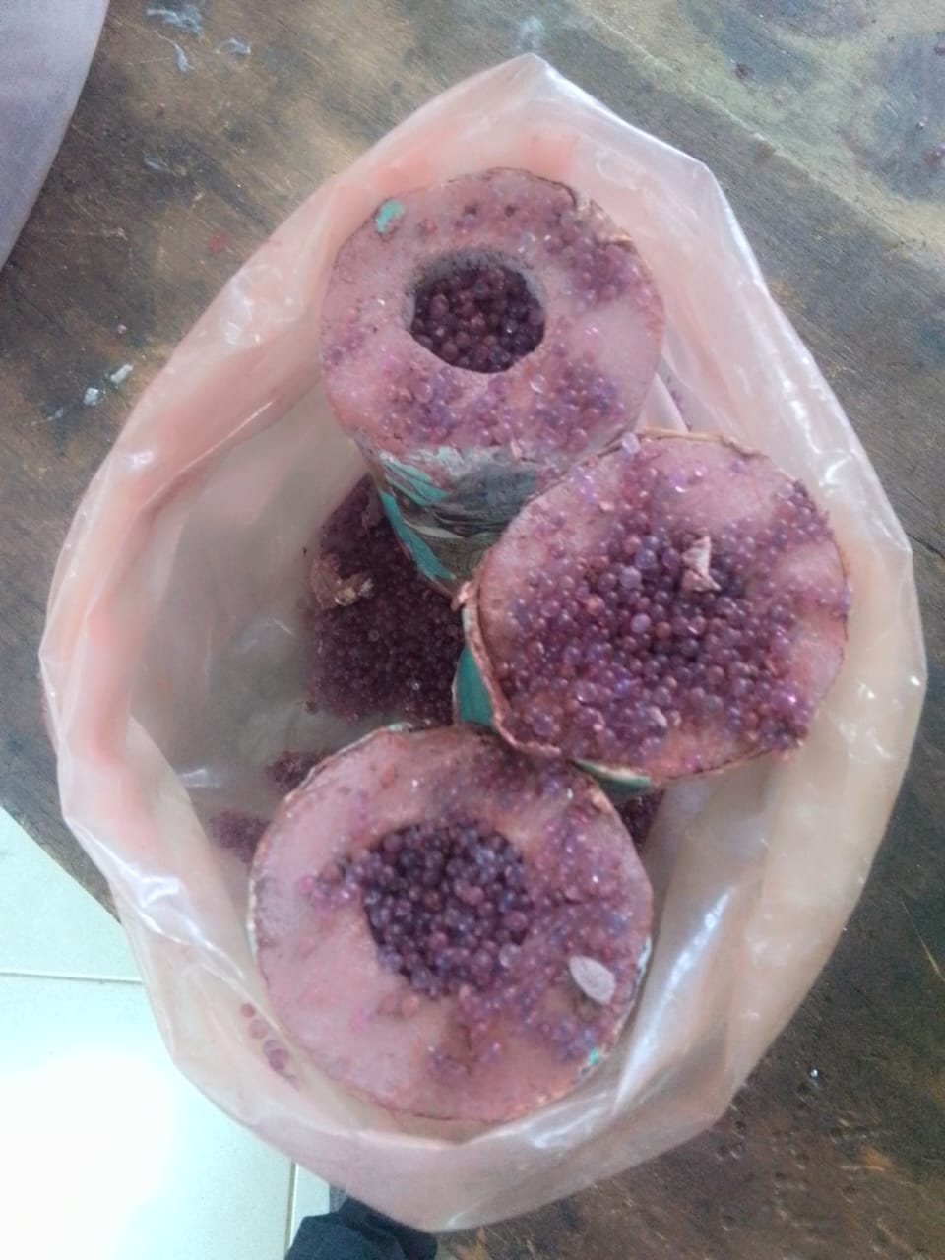
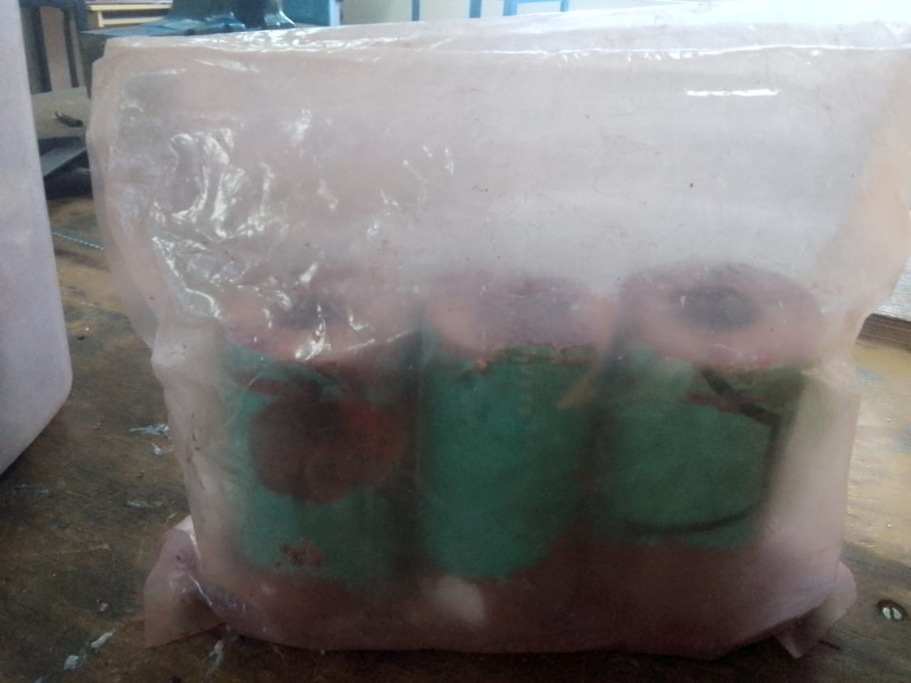
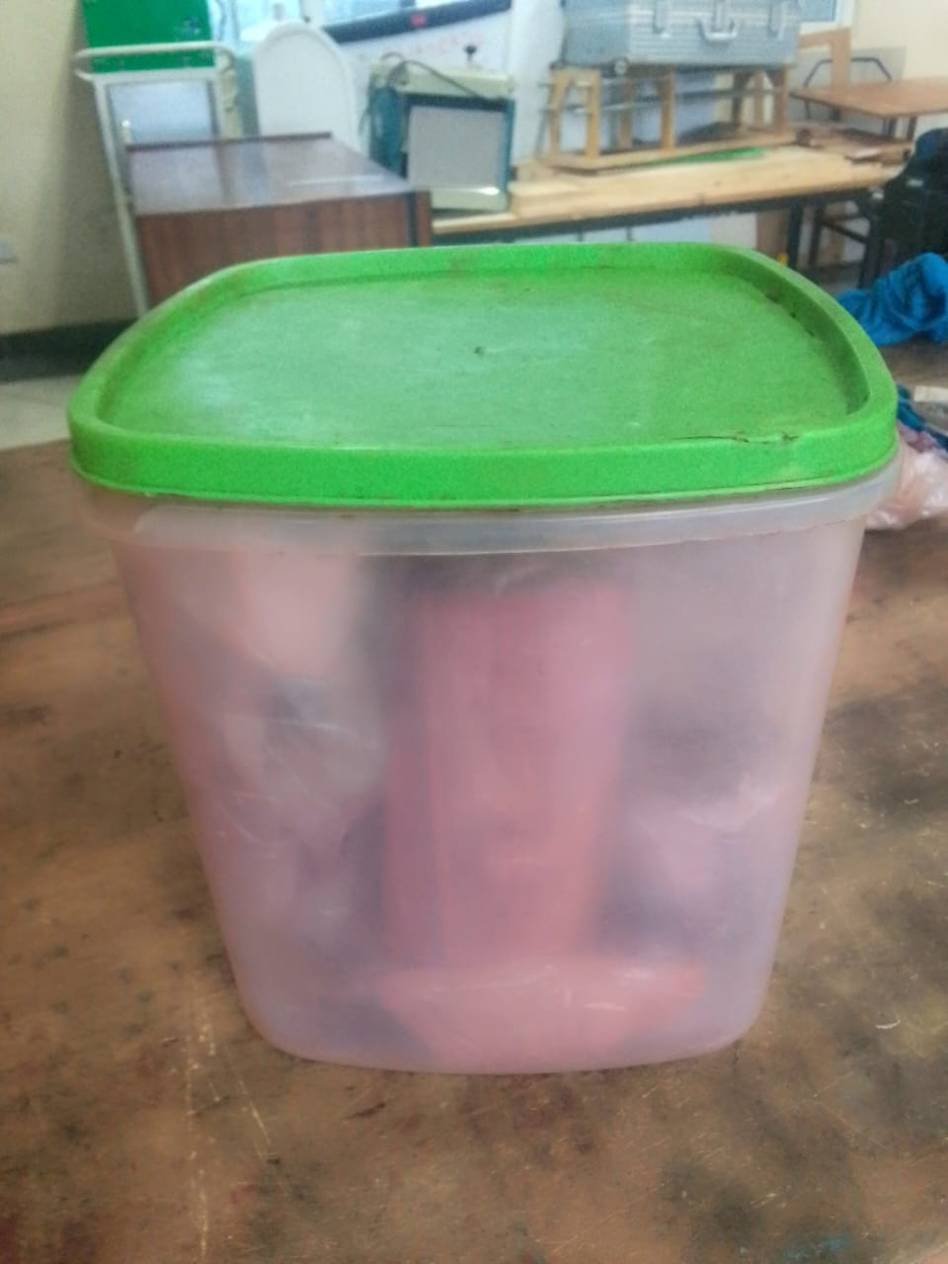
Storage of grains
Using silica gel
Using ziplocks
Storage container

Slide 13
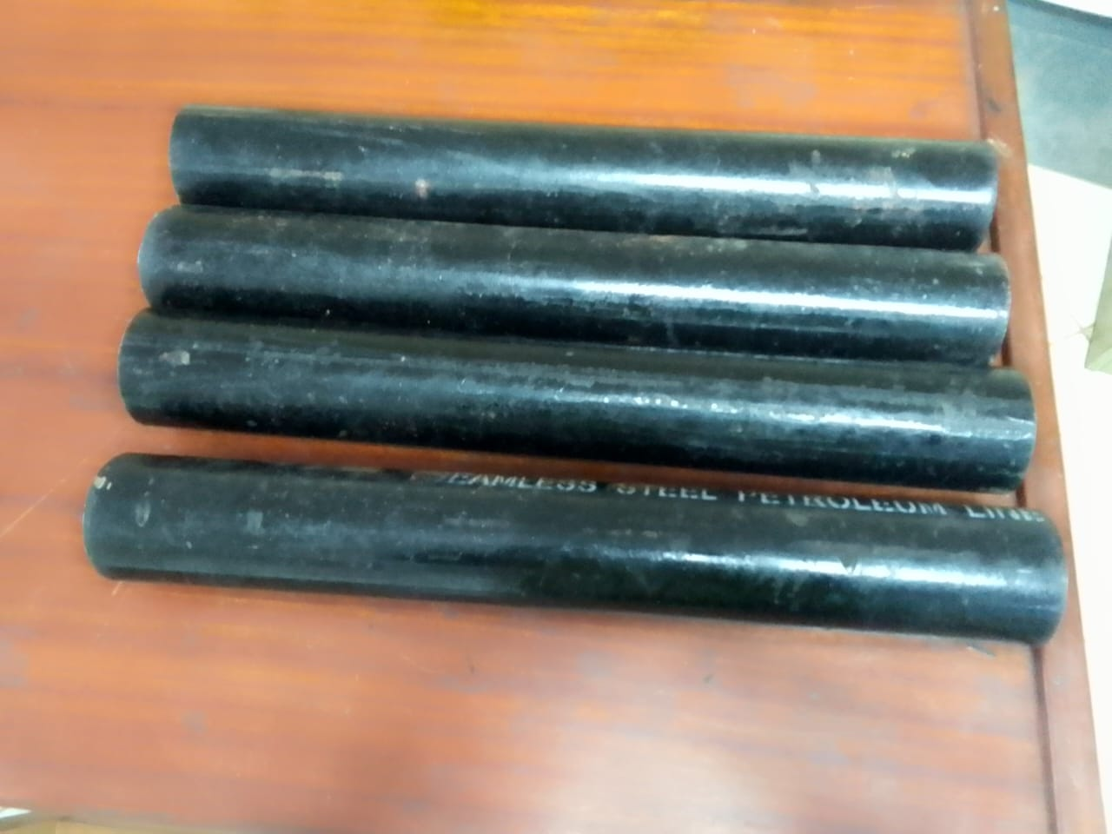
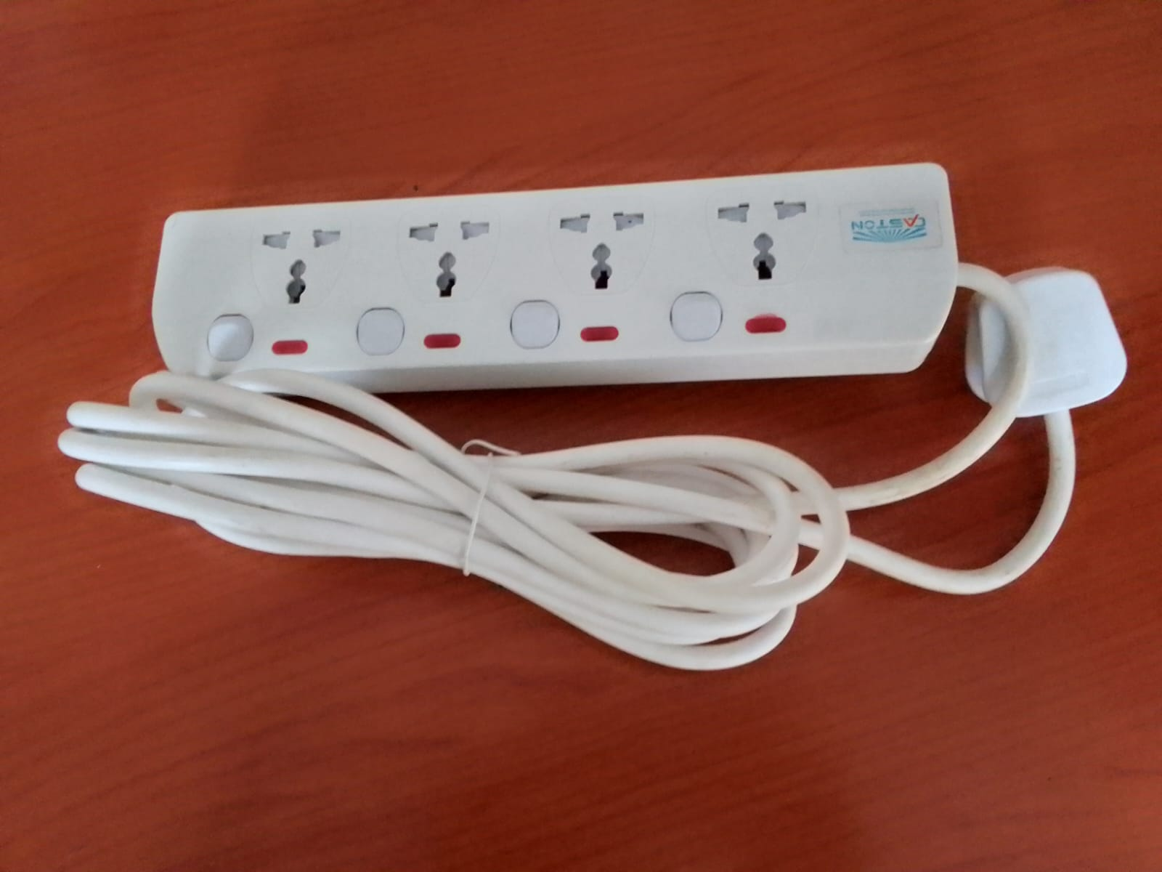
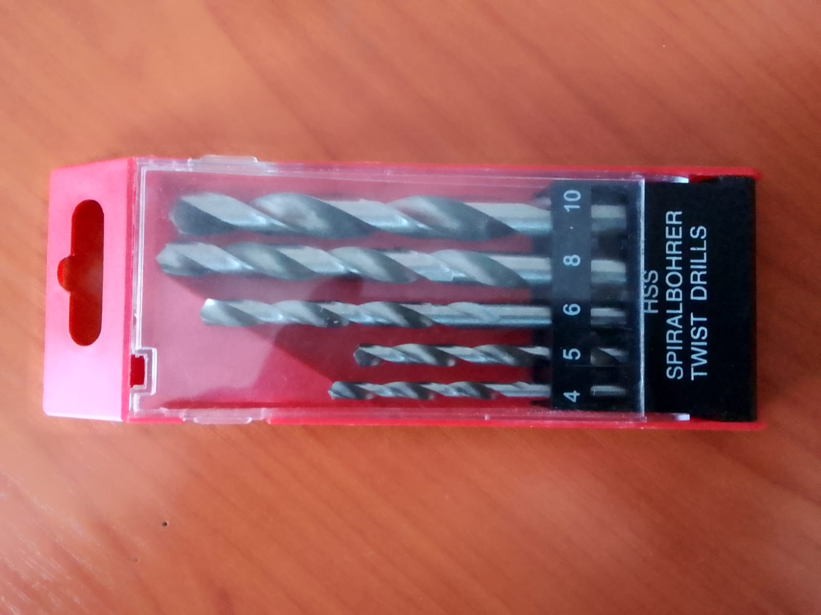
#115 Items procured this week
Motor casing tube
Power extension
Drill bits (4-10mm)

Slide 14
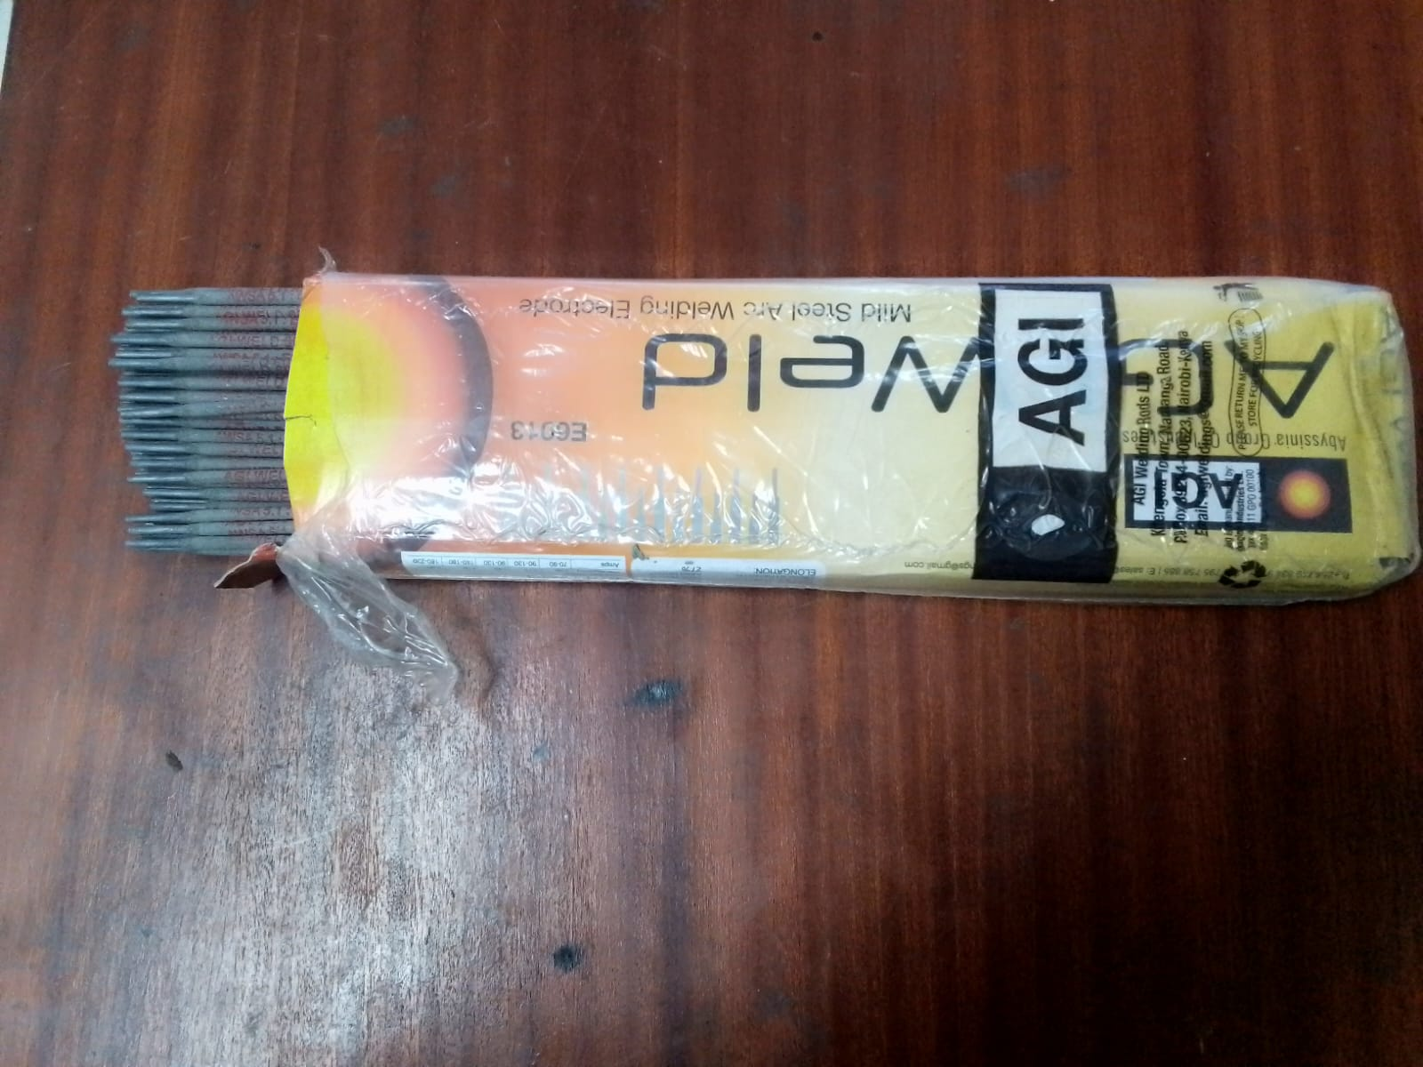
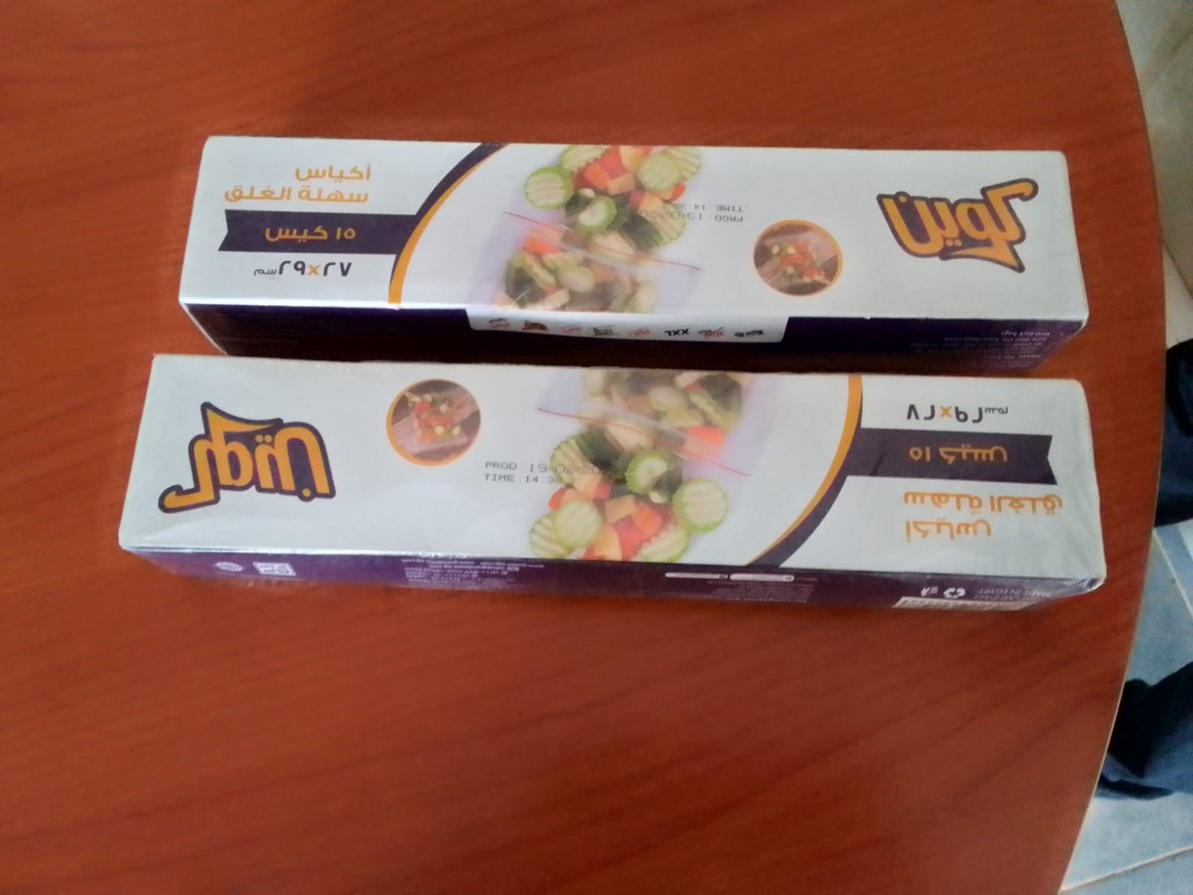
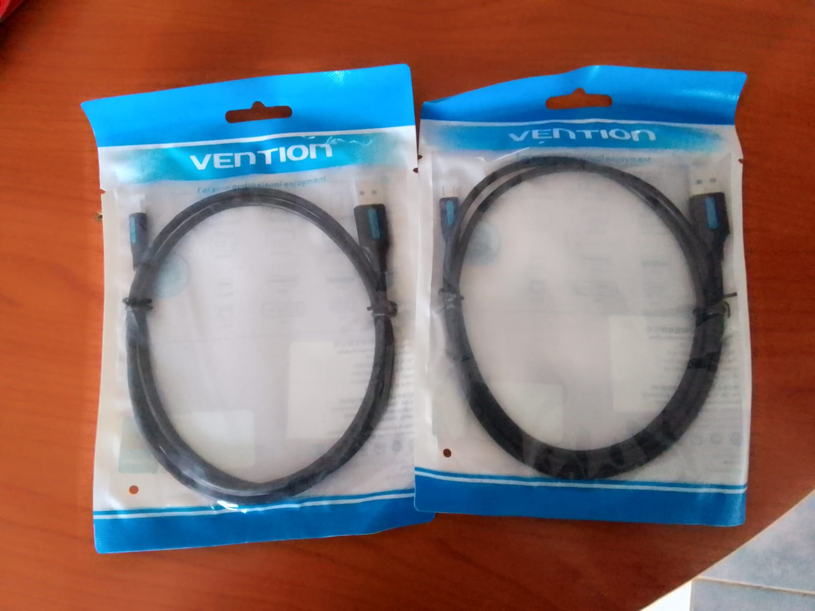
Continued
Welding electrodes
Ziplocks
Data cable

Slide 15
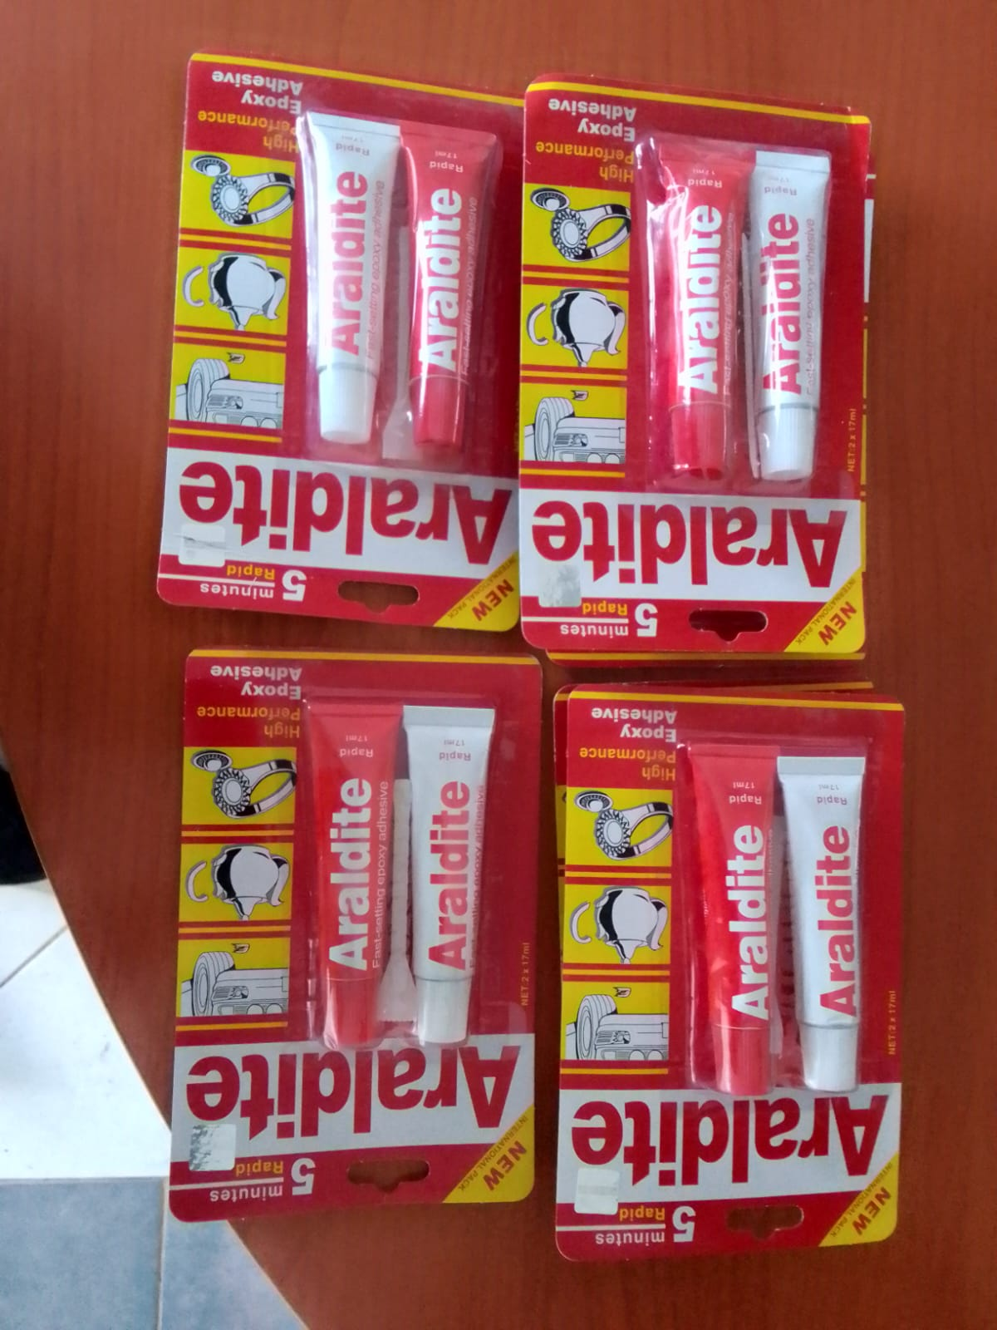
Continued
Epoxy

Slide 16
Tasks to done next week
Machining of motor casing # 101
3D printing of grain casting molds # 111
Static test; including the airframe #114
Cooking grains # 83

Slide 17
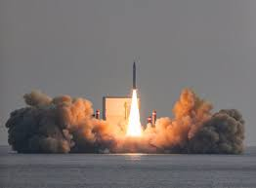
Thank You

